Slide 1
Assembly Language Basics
TEXT 2 (CHAPTER 3)
Visit: http://kipirvine.com/asm/gettingStartedVS2012/index.htm for instructions on how to set up the programming environment.

Slide 2
Assembly language is not that difficult to learn.
Writing programs that are useful however requires a comparatively large amount of code.
CODE: OUR FIRST PROGRAM BLOCK
main PROC
mov eax,5 ; move 5 to the EAX register
add eax,6 ; add 6 to the EAX register
call WriteInt ; display value in EAX
Exit ; quit
main ENDP

Slide 3
Integers
An integer constant (or integer literal) is made up of an optional leading sign, one or more digits, and an optional suffix character.
The Syntax: [{+|−}] digits [radix]
The radix may be one of the following:
h Hexadecimal r Encoded real
q/o Octal t Decimal (alternate)
d Decimal y Binary (alternate)
b Binary
If no radix is given, the integer constant is assumed to be decimal. Examples?

Slide 4
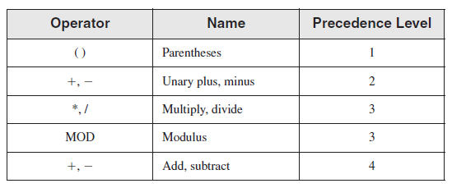

An integer expression is a mathematical expression involving integer values and arithmetic operators.
The expression must evaluate to an integer, which can be stored in 32 bits (0 through FFFFFFFFh).
What does the following evaluate to: $18/2∗2/3/2∗2∗2−6+2+4/2∗2$?

Slide 5
Identifiers
An identifier is a programmer-chosen name. It might identify a variable, a constant, a procedure, or a code label.
RULES:
They may contain between 1 and 247 characters. They are not case sensitive.
The first character must be a letter (A..Z, a..z), underscore (_), @ , ?, or $. Subsequent characters may also be digits.
An identifier cannot be the same as an assembler reserved word.
EXAMPLE: IDENTIFIERS
?hello how 34543 ?myCRopee
$money _9999 open_file var9

Slide 6
Directives
A directive is a command embedded in the source code that is recognized and acted upon by the assembler.
Directives do not execute at runtime.
We will use directives for two main purposes
To define variables and procedures.
Example: myVar DWORD 26 ; DWORD directive
To define program sections or segments
i.e. .data , .code, .stack size

Slide 7
Instructions
An instruction is a statement that becomes executable when a program is assembled.
Instructions are translated by the assembler into machine language bytes, which are loaded and executed by the CPU at runtime.
An instruction contains four basic parts:
Label (optional)
Instruction mnemonic (required)
Operand(s) (usually required)
Comment (optional)
CODE: SYNTAX
[label:] mnemonic [operands] [;comment]

Slide 8
Labels
A label is an identifier that acts as a place marker for instructions and data.
A label placed just before an instruction/variable implies its address.
A data label identifies the location of a variable.
It is possible to define multiple data items following a label.
EXAMPLE: LABELS
count DWORD 100
array DWORD 1024, 2048
DWORD 4096, 8192

Slide 9
Code Labels
Code labels are used as targets of jumping and looping instructions.
Each code label must end with a semicolon.
A code label can share the same line with an instruction, or it can be on a line by itself:
CODE: ILLUSTRATING CODE LABELS
target:
mov ax,bx
...
jmp target

Slide 10
Instruction Mnemonics
An instruction mnemonic is a short word that identifies an instruction.
Assembly language instruction mnemonics such as mov, add, and sub provide hints about the type of operation they perform.
These mnemonics are sometimes referred to as the opcode.
EXAMPLE: COMMON MNEMONICS
mov Move (assign) one value to another
Add Add two values
sub Subtract one value from another
mul Multiply two values
jmp Jump to a new location
call Call a procedure

Slide 11
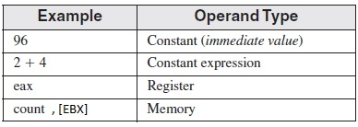
Operands
Assembly language instructions can have between zero and three operands.
An operand can be a register, memory operand, constant expression, or input-output port.
A memory operand is specified by the name of a variable or by one or more registers containing the address of a variable.

Slide 12
The STC instruction has no operand:
stc ; set carry flag
The INC instruction has one operand:
inc eax ; add 1 to eax
The MOV instruction has two operands:
mov count, ebx ; move EBX to count
The IMUL instruction has 3 operands:
imul eax,ebx,5 ; multiply ebx by 5 and store the result in eax
In a two-operand instruction, the first operand is called the destination. The second operand is the source.

Slide 13
Comments
Comments can be specified in two ways:
Single-line comments begin with a semicolon (;). All characters following the semicolon on the same line are ignored.
; this is a comment in ASL
Block comments begin with the COMMENT directive and a user-specified symbol.
All subsequent lines of text are ignored by the assembler until the same user-specified symbol appears.
Comment !
Everything here is a comment
I am also a comment
!

Slide 14
Example: Adding and Substracting Integers
CODE: ILLUSTRATING A FULL ASSEMBLY LANGUAGE PROGRAM
TITLE Add and Subtract (AddSub.asm)
; This program adds and subtracts 32-bit integers.
INCLUDE Irvine32.inc
.code
main PROC
mov eax,10000h ; EAX = 10000h
add eax,40000h ; EAX = 50000h
sub eax,20000h ; EAX = 30000h
call DumpRegs ; display registers
exit
main ENDP
END main

Slide 15

Program Output The following is a snapshot of the program’s output, generated by the call to DumpRegs:
QUICK NOTE: THE NOP INSTRUCTION
The safest (and the most useless) instruction you can write is called NOP (no operation).
It takes up 1 byte of program storage and doesn’t do any work.
00000000 66 8B C3 mov ax,bx
00000003 90 nop ; align next instruction
00000004 8B D1 mov edx,ecx

Slide 16
ASL Programming Style
As mentioned, programs are organized around segments, which are usually named code, data, and stack.
The code segment contains all of a program’s executable instructions. Ordinarily, the code segment contains one or more procedures, with one designated as the startup procedure.
In the AddSub program, the startup procedure is main.
Another segment, the stack segment, holds procedure parameters and local variables.
The data segment holds variables.

Slide 17
A simple template you can use
TITLE Program Template (Template.asm)
; Program Description:
; Author:
; Creation Date:
; Revisions:
; Date:
INCLUDE Irvine32.inc
.data
; (insert variables here)
.code
main PROC
; (insert executable instructions here)
exit
main ENDP
; (insert additional procedures here)
END main

Slide 18
Assembling, Linking, and Running Programs
A programmer uses a text editor to create a source file.
The assembler reads the source file and produces an object file, a machine-language translation of the program. Optionally, it produces a listing file.
The linker reads the object file, combines it with required procedures and produces the executable file.
The operating system loader utility reads the executable file into memory and branches the CPU to the program’s starting address, and the program begins to execute.

Slide 19
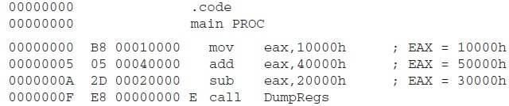
The listing file
A listing file contains a copy of the program’s source code, suitable for printing, with line numbers, offset addresses, translated machine code, and a symbol table.
A small part of the listing file generated by the AddSub.asm program

Slide 20
Data Definition
Intrinsic data types in MASM are only differentiated by their size in bits: 8,16,32,48,64 and 80.
Example: myvar WORD 1234H or myvar DW 1234h
Initializers are compulsory. If you do not want to set an initial value, use a question mark.
Example myvar DWORD ?
SYNTAX: DEFINING DATA
[name] directive initializer [,initializer]...

Slide 21
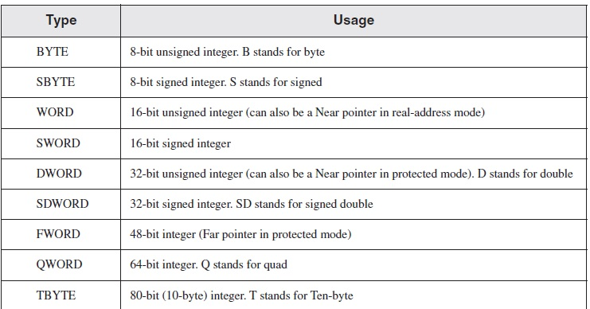
MASM Data Types

Slide 22
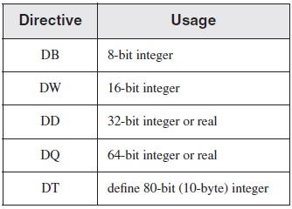
ASL Legacy Data Types

Slide 23
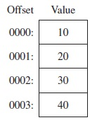
Multiple initializers can be used in the same data definition as in:
mylist BYTE 10,20,30,40,50
In this case, the label (mylist) refers only to the first item. Remaining items are stored in subsequent memory locations.
If mylist has an offset of 0000, then the above declaration has the following layout.
Within a single data definition, its initializers can use different radixes. Character and string constants can be freely mixed.
list BYTE 10, ‘W’, 41h, 00100010b;

Slide 24
Strings
To define a string of characters, enclose them in single or double quotation marks, as in:
greeting1 BYTE "Good afternoon",0
greeting2 BYTE 'Good night',0
The most common type of string ends with a null byte (containing 0).
Each character will take up one byte of storage.
A string can be divided between multiple lines without having to supply a label for each line:
Welcome_message1 BYTE “Welcome to COE 381”, 0dh, 0ah,
BYTE “This is a very easy course to understand.”, 0
Hexadecimal codes 0d and 0a produce a carriage return.

Slide 25
The DUP Operator
The DUP operator can be used to assign a single value to multiple memory locations.
It can be used with both uninitialized and initialized data.
Examples:
BYTE 20 DUP(0)
BYTE 20 DUP(?)
BYTE 4 DUP("STACK")

Slide 26
SELF TEST EXERCISE
Rewrite the ASL program addSub.asm of slide 14, by replacing all immediate values with variables.

Slide 27
Symbolic Constants
It is possible to create constants in ASL.
The values of constants cannot change at runtime.
Constants can however be redefined during assembly time.
COUNT = 5
mov al,COUNT ; AL = 5
COUNT = 10
mov al,COUNT ; AL = 10
COUNT = 100
mov al,COUNT
SYNTAX: DEFINING SYMBOLS
name = initializer eg. COUNT = 10; Esc_key = 27

Slide 28
Endianness
Generically “endianness” refers to the way sub-elements are numbered within an element, for example the way that bytes are numbered in a word.
In little-endian addressing, the lowest byte (or bit) is stored in the lowest address.
In big-endian addressing, the most significant byte (or bit) is stored in the least address.
Example: considering the instruction, how is the number 12345678 stored, if count begins at offset 0000?
count DD 12345678h
x86 processors store and retrieve data from memory using little endian order.

Slide 29
The $ operator
In ASL, the $ operator also known as the current location counter returns the offset associated with the current program statement.
The following statements set LISTSIZE to 0008, given that list is located at address 0000.
mylist WORD 1234h,2500h, 12, 12;
MYLISTSIZE = $;
For this to be useful the $ statement has to follow the mylist statement immediately.
Example: what is the value of ListSize?
list BYTE 10,20,30,40
var2 BYTE 20 DUP(?)
ListSize = ($ - list)
The $ operator can be used to calculate the size of arrays and strings.

Slide 30
The EQU directive
The EQU directive associates a symbolic name with an integer expression or some arbitrary text.
Unlike the = directive, a symbol defined with EQU can never be redefined in the same source code file.
SYNTAX: DEFINING SYMBOLS WITH EQU
name EQU expression egs. PI EQU <3.142>
name EQU symbol pressKey EQU <“Press any key to continue…”, 0>
name EQU <text>

Slide 31
The TEXTEQU directive
The TEXTEQU directive, similar to EQU, creates what is known as a text macro.
Unlike symbols created with EQU, text macros can be redefined at any time.
The can also build on each other as in the following example.
SYNTAX: DEFINING SYMBOLS WITH TEXTEQU
name TEXTEQU <text>
name TEXTEQU textmacro
name TEXTEQU %constExpr

Slide 32
SELF TEST EXERCISE
After executing the code below, what will the statement setupAL translate to?
rowSize = 5
count TEXTEQU %(rowSize * 2)
move TEXTEQU <mov>
setupAL TEXTEQU <move al,count>

Slide 33
SELF TEST EXERCISES
1. Declare a symbolic constant using the equal-sign directive that contains the ASCII code (08h) for the Backspace key.
2. Declare a symbolic constant named SecondsInDay using the equal-sign directive and assign it an arithmetic expression that calculates the number of seconds in a 24-hour period.
3. Write a statement that causes the assembler to calculate the number of bytes in the following array, and assign the value to a symbolic constant named ArraySize:
myArray WORD 20 DUP(?)
4. Show how to calculate the number of elements in the following array, and assign the value to a symbolic constant named ArraySize:
myArray DWORD 30 DUP(?)
5. Use a TEXTEQU expression to redefine “PROC” as “PROCEDURE.”

